Slide 1

Leo Mak Car Sales Analysis & Insights
Understanding trends and patterns in vehicle sales
Notes:
AI-generated content may be incorrect. ---

Slide 2

Introduction and Scope
Overview
Sales Data Overview
Analysis covers units sold by make, revenue by month and model, and sales by day of week.
Vehicle Characteristics
Examines popular vehicle features such as body shape, color, and transmission type influencing sales.
Data-Driven Insights
Insights identify trends from thousands of records to guide inventory and marketing strategies.
Notes:
--- This slide references information from the following file: https://wsuacza-my.sharepoint.com/personal/nbuka_wsu_ac_za/_layouts/15/Doc.aspx?sourcedoc=%7B51903B36-31F6-4F00-A780-10D909D4C252%7D&file=Processed%20Data%20Excel.xlsx&action=default&mobileredirect=true This presentation provides a comprehensive analysis of auto sales data, focusing on key metrics such as units sold by make, total revenue by month and model, and sales distribution by day of the week. It also explores the most popular vehicle characteristics including body shape, color, and transmission type. The insights are derived from a detailed dataset containing thousands of records, which were processed to identify trends and patterns that influence high and low sales performance. The goal is to equip stakeholders with actionable intelligence to optimize inventory, marketing strategies, and operational planning.

Slide 3

Units Sold by Make
Sales Performance by Make and Day
Make | Units Sold
Ford | 166,000
Chevrolet | 154,000
Nissan | 164,000
Toyota | 59,000
Honda | 20,000
Notes:
--- This slide references information from the following file: https://wsuacza-my.sharepoint.com/personal/nbuka_wsu_ac_za/_layouts/15/Doc.aspx?sourcedoc=%7B51903B36-31F6-4F00-A780-10D909D4C252%7D&file=Processed%20Data%20Excel.xlsx&action=default&mobileredirect=true The analysis of units sold by make reveals that Ford is the top-selling brand, significantly outperforming other manufacturers. The top five makes collectively account for a substantial portion of total sales, indicating a concentration of consumer preference. This trend suggests that maintaining a robust inventory of these leading brands could enhance sales performance. The data also highlights the importance of brand recognition and customer loyalty in driving unit sales.

Slide 4
Units Sold by Day of the Week
Day | Units Sold | Percentage
Tuesday | 166,000 | 29.72%
Friday | 154,000 | 27.51%
Sunday | 164,000 | 29.34%
Wednesday | 59,000 | 10.58%
Thursday | 16,000 | 2.82%
Notes:
--- This slide references information from the following file: https://wsuacza-my.sharepoint.com/personal/nbuka_wsu_ac_za/_layouts/15/Doc.aspx?sourcedoc=%7B51903B36-31F6-4F00-A780-10D909D4C252%7D&file=Processed%20Data%20Excel.xlsx&action=default&mobileredirect=true Sales distribution across the days of the week shows a clear peak on Tuesdays, followed closely by Fridays and Sundays. This pattern suggests that mid-week and weekend days are optimal for sales activities, possibly due to consumer availability and dealership operations. Understanding these temporal trends can help in scheduling promotions, staffing, and inventory restocking to align with peak demand periods.

Slide 5
Total Revenue by Month
Revenue Trends
Month | Total Revenue
September | R40M
February | R30M
January | R20M
June | R10M
May | R0M
Notes:
--- This slide references information from the following file: https://wsuacza-my.sharepoint.com/personal/nbuka_wsu_ac_za/Documents/Microsoft%20Copilot%20Chat%20Files/PowerBI.pdf Monthly revenue analysis indicates that September is the peak month for total revenue, followed by other months with varying performance. This seasonality suggests that consumer behavior and market conditions fluctuate throughout the year. Aligning marketing campaigns and inventory planning with these revenue peaks can enhance profitability and operational efficiency.

Slide 6
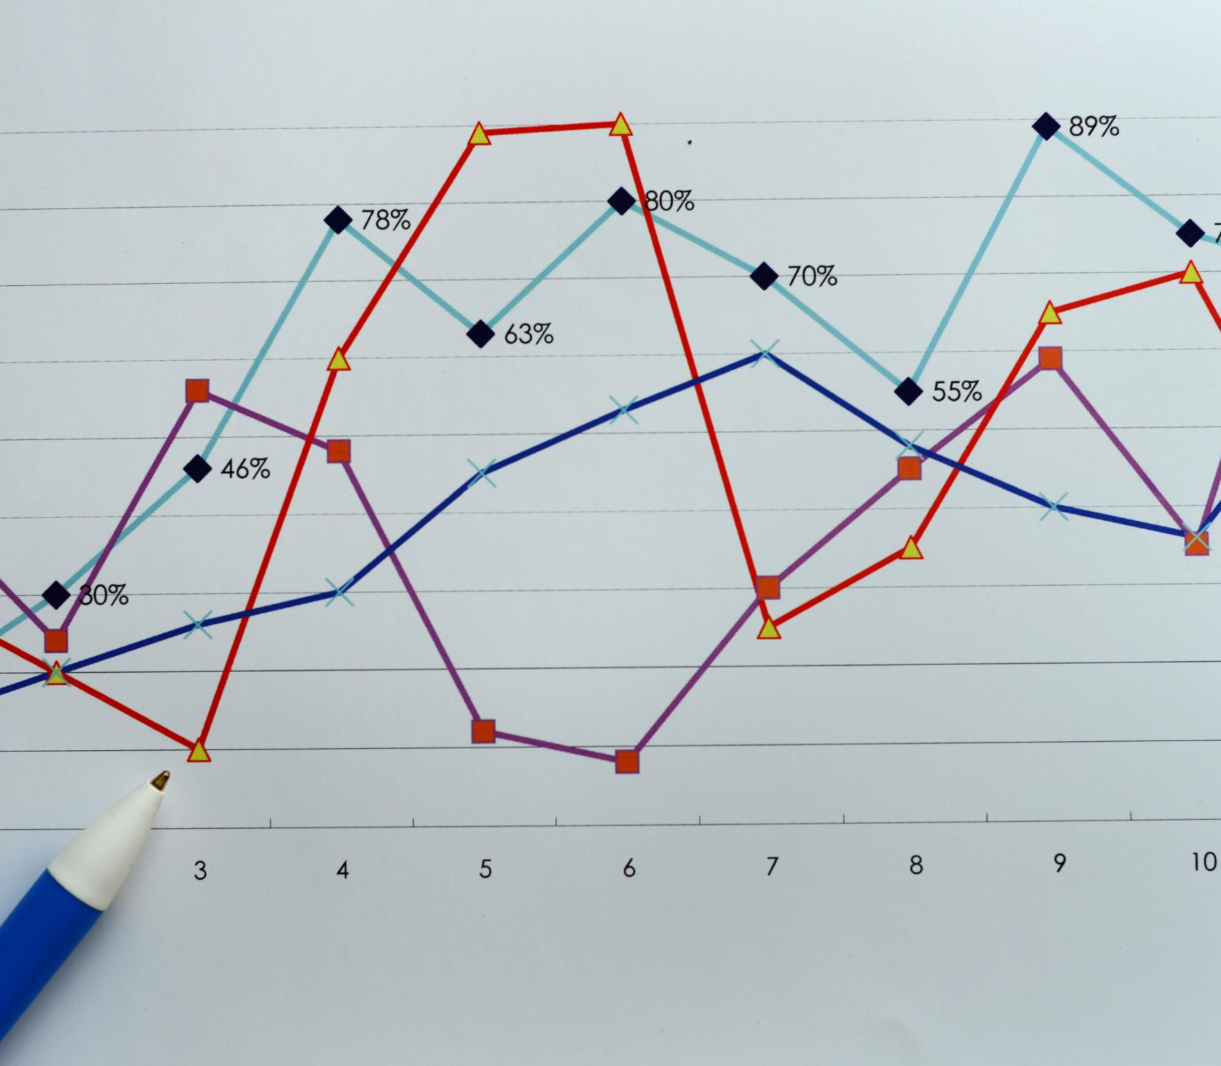
Revenue by Month and Model
Top-Performing Models
Certain vehicle models consistently lead in revenue generation over several months, highlighting demand trends.
Monthly Revenue Trends
Analyzing revenue by month reveals peak periods and supports inventory planning for high-demand models.
Inventory and Sales Strategy
Understanding revenue patterns assists in ensuring availability of popular models during peak sales months.
Notes:
--- This slide references information from the following file: https://wsuacza-my.sharepoint.com/personal/nbuka_wsu_ac_za/Documents/Microsoft%20Copilot%20Chat%20Files/PowerBI.pdf The breakdown of revenue by month and model highlights the top-performing vehicle models that contribute significantly to monthly earnings. Models such as the 1 Series, 1500, and 190-Class show consistent revenue generation across multiple months. This insight is valuable for identifying high-demand models and ensuring their availability during peak sales periods.

Slide 7
Sales by Body Type
Vehicle Characteristics and Sales
Dominant Vehicle Types
Sedans and SUVs lead sales due to their balance of practicality, comfort, and style.
Consumer Preferences
Consumer choices are influenced by needs for comfort, style, and practicality in vehicle selection.
Marketing and Inventory Insights
Sales data helps optimize inventory and marketing strategies to match customer demand effectively.
Notes:
--- This slide references information from the following file: https://wsuacza-my.sharepoint.com/personal/nbuka_wsu_ac_za/_layouts/15/Doc.aspx?sourcedoc=%7B51903B36-31F6-4F00-A780-10D909D4C252%7D&file=Processed%20Data%20Excel.xlsx&action=default&mobileredirect=true Analysis of vehicle body types reveals that certain shapes, such as sedans and SUVs, dominate sales figures. These preferences reflect consumer needs for practicality, comfort, and style. Understanding which body types are most popular can guide inventory decisions and marketing strategies to align with customer demand.

Slide 8

Sales by Color
Popular Neutral Colors
Black, silver, and gray lead vehicle color sales due to their neutral and versatile appeal.
Resale Value Advantage
Neutral colors are linked to higher resale values and broader customer acceptance.
Dealer Stock Strategy
Dealers can boost sales by stocking vehicles in these preferred colors to meet customer demand.
Notes:
--- This slide references information from the following file: https://wsuacza-my.sharepoint.com/personal/nbuka_wsu_ac_za/_layouts/15/Doc.aspx?sourcedoc=%7B51903B36-31F6-4F00-A780-10D909D4C252%7D&file=Processed%20Data%20Excel.xlsx&action=default&mobileredirect=true Color trends in vehicle sales show a strong preference for neutral tones such as black, silver, and gray. These colors are often associated with resale value and broad appeal. Dealers can leverage this insight to stock vehicles in preferred colors, thereby increasing the likelihood of quicker sales and customer satisfaction.

Slide 9

Sales by Transmission Type
Preference for Automatic Vehicles
Consumers show a strong preference for automatic transmission due to ease of use and comfort in driving.
Consumer Expectations
Automatic cars meet consumer expectations for convenient and comfortable driving experience.
Stocking Strategy
Increasing stock of automatic vehicles can improve sales turnover and meet majority demand.
Notes:
--- This slide references information from the following file: https://wsuacza-my.sharepoint.com/personal/nbuka_wsu_ac_za/_layouts/15/Doc.aspx?sourcedoc=%7B51903B36-31F6-4F00-A780-10D909D4C252%7D&file=Processed%20Data%20Excel.xlsx&action=default&mobileredirect=true Transmission type analysis indicates a dominant preference for automatic vehicles. This trend aligns with consumer expectations for ease of use and driving comfort. Stocking more automatic vehicles can cater to the majority of buyers and improve turnover rates.

Slide 10

Drivers of High and Low Sales
Factors Driving High Sales
High sales result from mid-week activity, competitive pricing, and availability of popular models and colors.
Causes of Low Sales
Low sales often occur during weekends or when inventory has niche trims or higher-priced vehicles.
Strategies to Enhance Sales
Align promotions with peak days, maintain stock of high-demand models, and price vehicles competitively.
Notes:
--- This slide references information from the following file: https://wsuacza-my.sharepoint.com/personal/nbuka_wsu_ac_za/_layouts/15/Doc.aspx?sourcedoc=%7B51903B36-31F6-4F00-A780-10D909D4C252%7D&file=Processed%20Data%20Excel.xlsx&action=default&mobileredirect=true High sales are typically driven by factors such as mid-week activity, competitive pricing, and availability of popular models and colors. Conversely, low sales often occur during weekends or when inventory includes niche trims or higher-priced vehicles. Aligning promotional efforts with peak days, maintaining stock of high-demand models, and pricing vehicles competitively are key strategies to enhance sales performance.

Slide 11
Summary and Next Steps
Conclusion
Sales Highlights
Ford is the top-selling make, with Tuesday as the busiest sales day and September the peak revenue month.
Popular Vehicle Features
Sedan body types, black and silver colors, and automatic transmissions are the most popular vehicle traits.
Next Steps in Analysis
Further analysis by seller and region, pricing comparisons, and promotional timing tests will optimize sales.
Notes:
--- This slide references information from the following file: https://wsuacza-my.sharepoint.com/personal/nbuka_wsu_ac_za/_layouts/15/Doc.aspx?sourcedoc=%7B51903B36-31F6-4F00-A780-10D909D4C252%7D&file=Processed%20Data%20Excel.xlsx&action=default&mobileredirect=true The analysis highlights Ford as the top-selling make, Tuesday as the busiest sales day, and September as the peak revenue month. Popular vehicle characteristics include sedan body types, black and silver colors, and automatic transmissions. Next steps include deeper analysis by seller and geographic region, comparison of pricing against market benchmarks, and testing promotional timing to optimize sales outcomes.

